Slide 1
Case study for developmer position
Presenting: Mats Hoem Olsen
Date: 22/04-2024

Slide 2

Mats Hoem Olsen
Master student, Data science with spes. Mathematics and statistics with understanding in soil Physics
Applicant for position of developer of databases for Statensvegvesen

Slide 3
Python case
Time Complexety:
O(n) where n is number of lines in file
String match has a complexety of O(k) where k = len(line)
Converts str -> automata

Slide 4
Show code for the good honorabel adudience
Text file
Program
Print result
Loop over file
Read file
Open file
Init varables
Close file
Terminate program

Slide 5
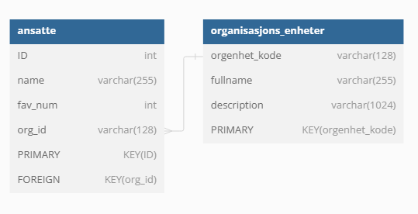
SQL case
Tools used
SQLite version 3.45.1 2024-01-30 16:01:20 (UTF-16 console I/O)

Slide 6
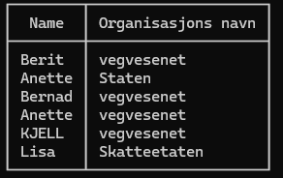
Task 1
Selects the relevant columns
Defines where to fetch the data
Defines how to merge the tables
SELECT
name as 'Name', fullname as 'Organisasjons navn’
FROM
ansatte
LEFT JOIN
organisasjons_enheter
ON
org_id = orgenhet_kode;

Slide 7
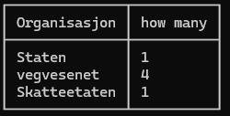
Task 2
Defines relevant columns
Defines where to fetch them
Spesifies how to merge them
Defines a grouping for ‘COUNT’ function
SELECT
fullname as 'Organisasjon’,
COUNT(*) as 'how many’
FROM
ansatte
LEFT JOIN
organisasjons_enheter
ON
org_id = orgenhet_kode
GROUP BY
org_id;

Slide 8

Any questions?

Slide 9
Thanks for me
The ending

